Slide 1
Introduction to Hadoop

Slide 2
Objectives:
Data
Data Storage and Analysis
Comparison with Other Systems
A Brief History of Hadoop
Apache Hadoop and the Hadoop Ecosystem
Hadoop Releases

Slide 3
Data
We live in the age called data.
It is not easy to measure the total volume of data stored electronically, but IDC(International Data Corporation) estimate is 0.18zettabytes in 2006 & 1.8 ZB in 2011.
1ZB=10^21 bytes
The data is coming from many sources:
The New York stock exchange generates about 1TB of new trade data per day.
Facebook hosts appro 10 billion photos, taking up 1PB of storage.
Etc

Slide 4
2. Data Storage & Analysis
The problem is simple i.e while the storage capacities of hard drives have increased massively over the years, but not the access speed(the rate at which data can be read from drives-have not kept up)
The time taken to read all the data on a single drive takes lot of time and writing is even too slow.
Solution:
to reduce the time solution is to read from multiple disks at once.

Slide 5
Problems:
Is to solve is hardware failure:
As the usage of hardware is high , the chance that one will fail is fairly high. A common way of avoiding data loss is through replication.
Problem is that most analysis tasks need to be able to combine the data in some way. Data read from one disk may need to be combined with the data from any of the other disks. Mapreduce provides a programming model that abstracts the problem from disk reads and writes transforming it into a computation over sets of keys and values. Mapreduce has built-in reliability.

Slide 6
Hadoop provides:
A reliable shared storage and analysis system.
The storage is provided by HDFS and analysis by Mapreduce.

Slide 7
3. Comparison with other systems
The approach taken by Map Reduce may seem like brute-force approach.
Map reduce is a batch query processor, and the ability to run an ad hoc query against ur whole dataset and get the results in a reasonable time is transformative.
RDBMS:
Q) Why can’t we use databases with lots of disks to do large-scale batch analysis? Why is map reduce needed?

Slide 8
Seek time is improving more slowly than transfer rate.
Seeking is the process of moving the disk’s head to a particular place on the disk to read & write data. Transfer rate corresponds to the bandwidth.
If the data access pattern is dominated by seeks, it will take longer time to read or write large portions of the dataset than streaming through it, which operates at the transfer rate.
For updating a small proportion of records in a database, a traditional B-Tree works well. For updating majority of a database, a B-Tree is less efficient than Mapreduce, which uses sort/merge to rebuild the database.
Mapreduce is good fit for problems that need to analyze the whole dataset, used particularly for ad-hoc analysis.
RDBMS is good for point queries or updates, where the dataset has been indexed to deliver low-latency retrieval and update time s of relatively small amount of data.
Mapreduce suits applications where the data is written once, and read many times, whereas a relational database is good for datasets that are continually updated.

Slide 9
RDBMS compared to map-reduce
 | Traditional RDBMS | MapReduce
Datasize | Gigabytes | Petabytes
Access | Interactive & batch | batch
Updates | Read & write many times | Write once, read many times
Structure | Static schema | Dynamic schema
Integrity | High | Low
Scaling | Nonlinear | Linear

Slide 10
Relational data is often normalized to retain its integrity and remove redundancy. Normalization poses problems for mapreduce, since it makes reading a record a non-local operation, & once the central assumptions that mapreduce makes is that it is possible to perform (high-speed) streaming reads & writes.
A web server log is a good example of a set of records that is not normalized, this is one reason that logfiles of all kinds are particularly well-suited to analysis with mapreduce.
Mapreduce is a linearly scalable programming model. The programmer writes two functions:
A map function
Reduce function

Slide 11
Grid Computing
Grid computing is a computer network in which each computer resource are shared with every other computer in the system.
The High Performance Computing(HPC) & Grid Computing communities have been doing large-scale data processing for years, using such API’s as Message Passing Interface(MPI).
Approach in HPC is to distribute the work across a cluster of machines, which access a shared file system. This works well to compute –intensive jobs, but becomes a problem when nodes need to access larger data volumes, since the network bandwidth is the bottleneck and compute nodes become idle.

Slide 12
Volunteer Computing
VC is a type of distributed computing in which computer owners or users donate their computing resources(such as processing power and storage) to one or more projects.
Volunteer computing projects work by breaking, the problem they are trying to solve into chunks called work units, which are sent to computers around the world to be analyzed.
Mapreduce is designed to run jobs that last minutes or hours on trusted, dedicated hardware running in a single data center with very high aggregate bandwidth interconnects.

Slide 13
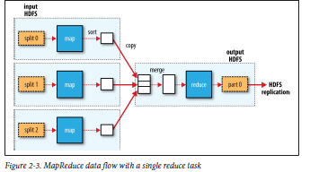

Slide 14
Mapreduce tries to allocate the data with the compute node, so data access is fast since it is local. This feature, known as data locality, which is at the heart of Mapreduce & is the reason for its good performance.
Coordinating the processes in a large-scale distributed computation is a challenge. The hardest aspect is handling partial failures- when you don’t know if a remote process has failed or not- and still making progress with the overall computation.
Map reduce spares the programmers from having to think about failure, since the implementation detects failed map or reduce tasks and reschedules replacements on machines that are healthy.

Slide 15
4. A brief History of Hadoop
Hadoop was created by Doug Cuttings.
Hadoop has its origins in Apache Nutch, an open source web search engine.
The name “Stuffed yellow elephant”.
Subprojects & “contrib” modules in Hadoop also tend to have names that are unrelated to their function, often with an elephant of other animal theme (“Pig”).
Smaller components are given more descriptive names. This is a good principle, as it means u can generally work out something does from its name.
Eg: Jobtracker keeps track of Mapreduce jobs.

Slide 16
Timeline of how things have progressed:
2004---> initial versions of what is now HDFS & Mapreduce implemented by Doug cuttings & Mike Cafarella.
Dec 2005---> Nutch ported to the new framework. Hadoop runs reliably on 20 nodes.
Jan 2006---> Doug Cuttings joins Yahoo.
Feb 2006---> Apache Hadoop project officially started to support the standalone development of mapreduce and HDFS.

Slide 17
Feb 2006 – Adoption of hadoop by Yahoo grid team.
April 2006– Sort benchmark(10GB/node) run on 188 nodes in 47.9hrs.
May 2006– Yahoo set up a hadoop research cluster—300 nodes.
May 2006– Sort benchmark run on 500 nodes in 42 hours(better hardware).
Oct 2006– Research cluster reaches 600 nodes.
Dec 2006– Sort benchmark run on 20 nodes in 1.8hrs,100 nodes in 3.3hrs, 500 nodes in 5.2hrs,900 nodes in 7.8hrs.
Jan 2007– Research cluster reaches 900nodes.
April 2007– Research clusters—2 clusters of 1000 nodes.
April 2008– won the 1terabytes sort benchmark in 209 sec on 900 nodes.

Slide 18
Oct 2008– Loading 10 terabytes of data per day on to research clusters.
March 2009– 17 clusters with a total of 24,000 nodes.
April 2009– Won the minute sort by sorting 500Gb in 59sec (on 1,400 nodes) & the 100 terabyte sort in 173 min (on 3,400 nodes).

Slide 19
Apache Hadoop & the Hadoop Ecosystem
Hadoop is best known for Mapreduce & HDFS, the term is suits for projects on areas of large scale data processing & infrastructure for distributed computing.
Common
A set of components and interfaces for distributed filessystems & general I/O(serialization,JavaRPC(remote procedure calls), persistent data structures).
Avro
A serialization system for efficient, cross-language RPC, & persistent data storage.
MapReduce
A distributed data processing model & execution environment that runs on large clusters of commodity machines.
HDFS
A distributed filesystem that runs on large clusters of commodity machines.
5. Pig

Slide 20
A data flow language and execution environment for exploring very large datasets. Pig runs on HDFS and Mapreduce clusters.
Hive
A distributed data warehouse. Hive manages data stored in HDFS and provides a query language based on SQL for querying the data.
Hbase
A distributed, column-oriented database. Hbase uses HDFS for its underlying storage, and supports both batch-style computations using MapReduce and point queries(random reads).
ZooKeeper
A distributed, highly available coordination service. ZooKeeper provides primitives such as distributed locks that can be used for building distributed applications.

Slide 21
Sqoop
A tool for efficiently moving data between relational databases and HDFS.
Hadoop Releases:
Features Supported by Hadoop Release series
Feature | 1.X | 0.22 | 0.23
Secure authentication | Yes | No | Yes
Old Configuration names | Yes | Deprecated | Deprecated
New Configuration names | No | Yes | Yes
Old Mapreduce API | Yes | Deprecated | Deprecated
New Mapreduce API | Partial | Yes | Yes
Mapreduce 1 runtime(Classic) | Yes | Yes | No
Mapreduce 2 runtime (YARN) | No | No | Yes
HDFS federation | No | No | Yes
HDFS high-availability | No | No | Planned

Slide 22
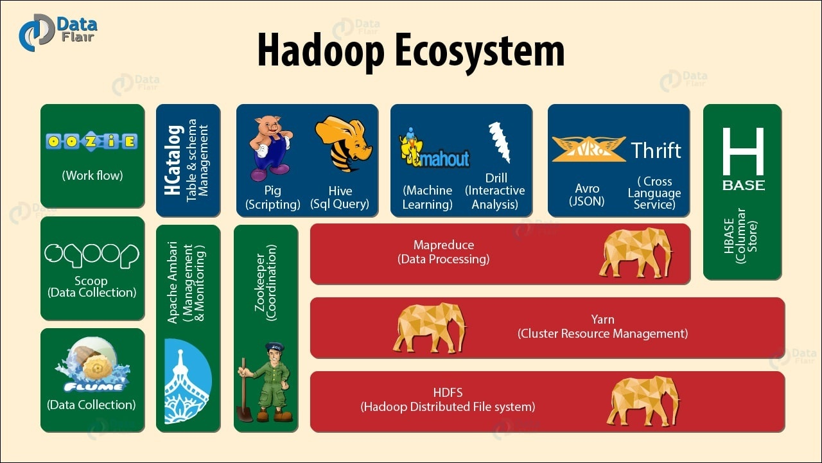
Image source : Data Flair

Slide 23
A new Mapreduce runtime, called Mapreduce 2, implemented on a new system called YARN ( Yet Another Resource Negotiator), which is a general resource management system for running distributed applications. Mapreduce 2 replaces the classic runtime in previous release.
Mapreduce API’s:
Provides two java mapreduce API’s. They are “ The old & the new Java Mapreduce API’s.
Compatibility:
API Compatibility, data compatibility and write compatibility.
API Compatibility:
Concerns the contract between user code and the published Hadoop API’s such as the java Mapreduce API’s.

Slide 24
Hadoop uses classification scheme for API elements to denote their stability.
Data Compatibility:
Concerns persistent data and metadata formats, such as the format in which the HDFS namenodes stores its persistent data.

